Slide 1
Homework
Week 6

Slide 2
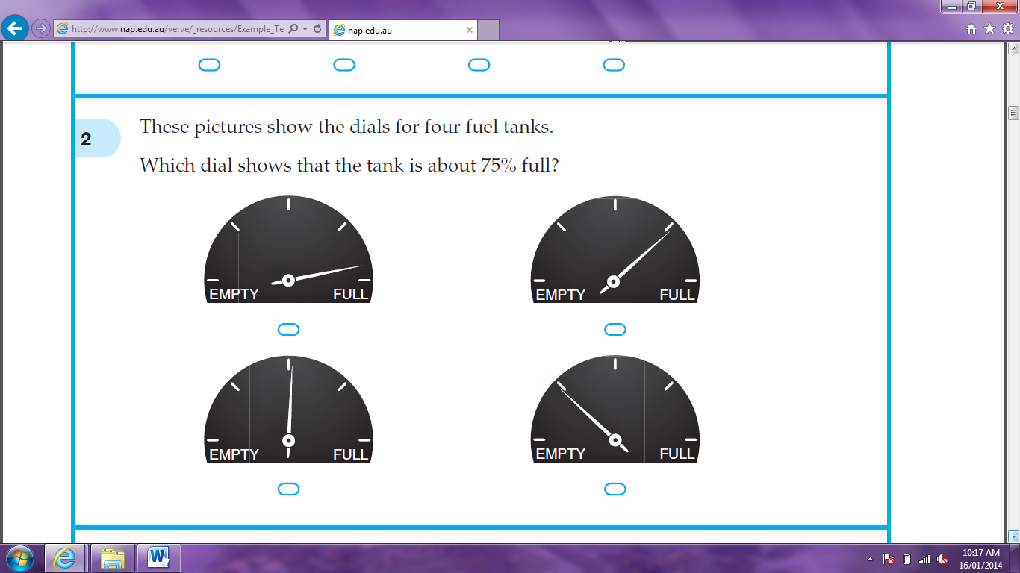
Question 1
These pictures show the dials for four fuel tanks. Which dial shows that the tank is about 75% full?
ANSWER = B

Slide 3
Question 2
ANSWER = 10

Slide 4
Question 3
Jenna bought a dozen oranges for $10.20. What was the average price per orange?
Average = $10.20 ÷ 12
= $0.85
ANSWER = $0.85

Slide 5
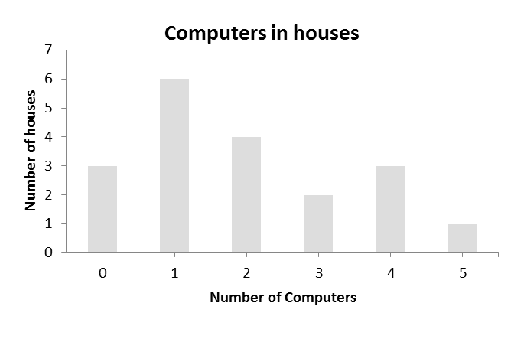
Question 4
The graph shows the number of computers in all the houses in a street. How many computers were there, altogether, in the street?
Total computers = 0 x 3 + 1 x 6 + 2 x 4 + 3 x 2 + 4 x 3 + 5 x 1
= 0 + 6 + 8 + 6 + 12 + 5
= 37
ANSWER = 37 Computers

Slide 6
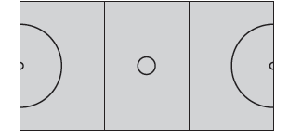
Question 5
Some shapes are shown on this netball court. Which shape is not shown?
Semicircle circle square rectangle
ANSWER = C

Slide 7
Question 6
When Eli moved to Australia, the population was 22 112 277 people. How many people is that to the nearest million?
ANSWER = 22 000 000 or 22 million

Slide 8
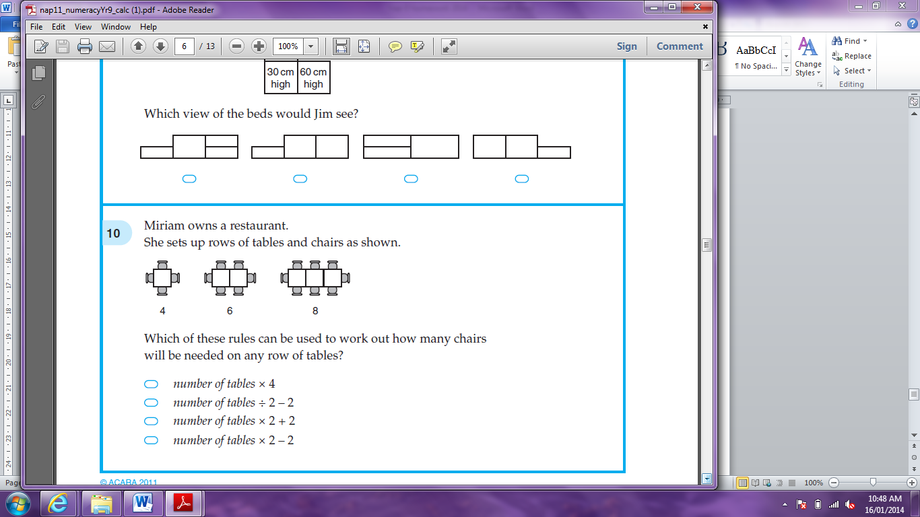
Question 7
Miriam owns a restaurant. She sets up rows of tables and chairs as shown. Which of these rules can be used to work out how many chairs will be needed on any row of tables?
Number of tables x 4
Number of tables ÷ 2 - 2
Number of tables x 2 + 2
Number of tables x 2 – 2
ANSWER = C

Slide 9
Question 8
What is the number 2 less than x?
-2x 2 – x x – 2 -2 – x
Answer = C

Slide 10
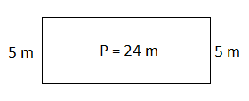

Question 10
A rectangle has a perimeter of 24 metres. The shorter sides are 5 metres long. How long are the longer sides?
Both Long sides = 24 – (2 x 5)
= 14 m
One long side = 14 ÷ 2
= 7 m
Answer = 7 m

Slide 11
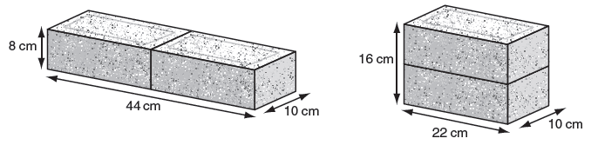
Question 11
Two bricks can be placed together face-to-face to form three different rectangular prisms. Two of them are shown below. Which would be the measurements of the third prism?
11cm by 16cm by 10cm
22cm by 20cm by 8cm
32cm by 22cm by 10cm
44cm by 16cm by 5cm
Answer = B

Slide 12
Question 12
Consider these scores: 3, 5, 5, 8, 12. Which changes if the score of 8 is removed?
mean median mode range
ANSWER = A
 | With Score 8 | Without Score 8
Mean | (3 + 5 + 5 + 8 + 12) ÷ 5= 6.6 | (3 + 5 + 5 + 12) ÷ 4= 6.25
Median | 5 | (5 + 5) ÷ 2 = 5
Mode | 5 | 5
Range | 12 – 3 = 9 | 12 – 3 = 9

Slide 13
Question 13
What is the value of ?
Answer = 0.58

Slide 14
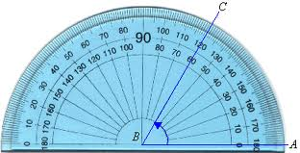
Question 14
What is the size of ?
= 60°
Answer =60°

Slide 15
Question 15
The cost in dollars to print n books is 500 + 10n. How many books are printed for a cost of $15 000?
$15 000 = 500 + 10n (-500)
$14 500 = 10n (÷10)
1 450 = n
Answer = 1 450 books

Slide 16

Question 16
A builder needs 6.5 cubic metres of concrete for a job. This table shows the mixture for the concrete. How many cubic metres of sand does the builder need?
Total parts = 2 + 4 + 6 + 1
= 13
1 part = 6.5 ÷ 13
= 0.5
Sand = 4 x 0.5
= 2 cubic metres
ANSWER = 2 cubic metres

Slide 17
Question 17
When t = -2, what is the value of 3t²?
3t² = 3 x (-2)²
= 3 x 4
= 12
Answer = 12

Slide 18
Question 18
What is the smallest number that is a multiple of both 12 and 15?
12: 12, 24, 36, 48, 60, 72…
15: 15, 30, 45, 60…
Answer = 60

Slide 19
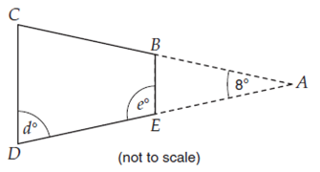
Question 19
In this drawing, ACD is an isosceles triangle and BC = DE. What are the sizes of the two marked angles, d and e?
e° = 180° - 86°
= 94°
Answer: d° = 86° and e° = 94°
Same as d°

